Slide 1
Average Screen Time
Presentation By: Hodo Ibrahim

Slide 2
About me
My name is Hodo Ibrahim
Currently a 3rd year student at Metro State studying Data Science.
First semester at Metro State.

Slide 3
Determining question
My question: Is my average daily screen time in hours, significantly different then the average American, according to data from DataReportal.

Slide 4
Data Collection Process
I started collecting data by turning on my phone and laptops “Screen Time” setting.
During the 14-day period, I was very strict with family and friends and did not allow them to use my phone or laptop.
I also did not allow myself to use any one's phone, laptop or iPad during the experiment.
Removed Google and Apple maps from the “Screen Time” setting on my phone that was using to calculate the daily screen time usage.
I used a timer to be able to collect the time when I was watching on a television or movie theater screen. I then added that time to the current day, to calculate the total screen time usage for that day.

Slide 5
Converting data to Decimals
To run test, we must convert minutes into a decimal form.
Converting minutes into a decimal form equation: Minutes/Total_minutes_in_an_hour
Ex. 5/60 = 0.08333333
Average American daily screen time is 7 hours and 4 minutes according to DataReportal.

Slide 6
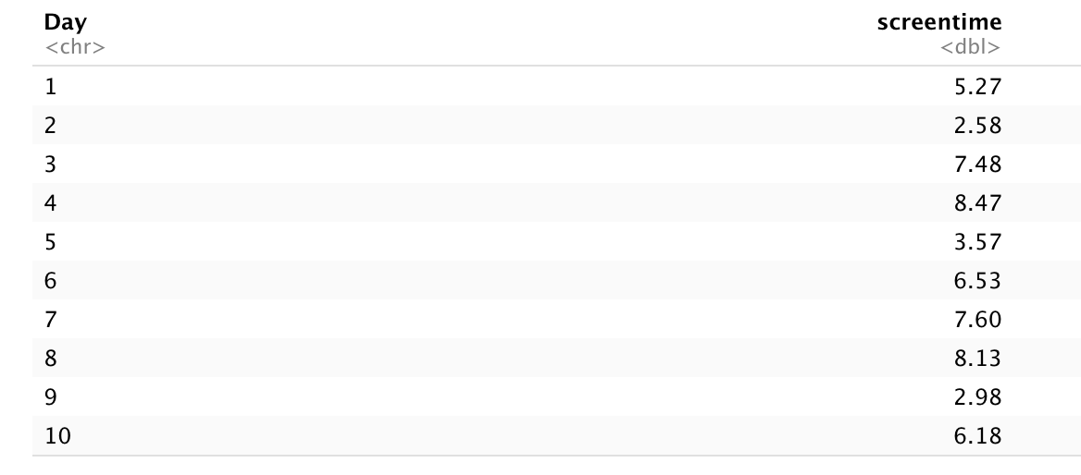
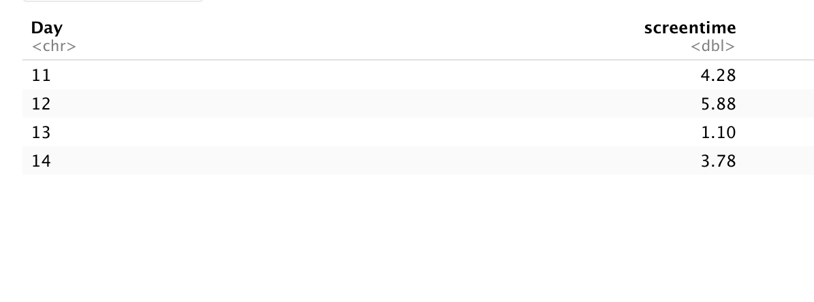
Data

Slide 7



Test Claim
Use the 0.05 significance level to test the claim that my average daily screen time is significantly different than the average American according to DataReportal.
H0: $=$ 7.07 H1: $≠$ 7.07
Test: Perform One-Samp T-test
$$μ$$
$$μ$$

Slide 8
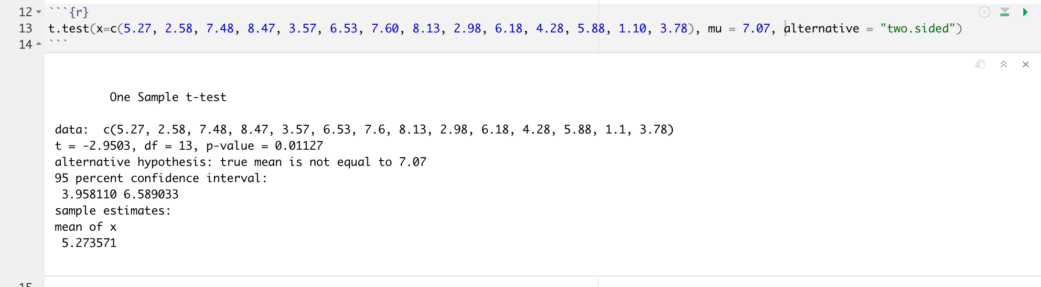
Testing claim using Rstudio

Slide 9
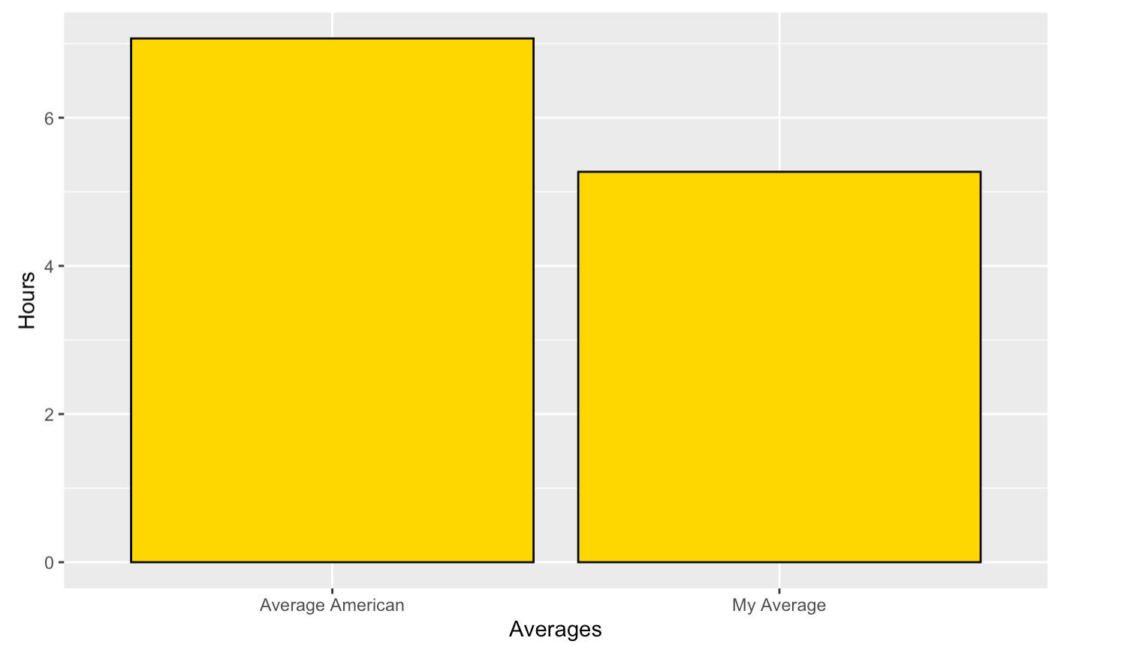
Make Decision
P-value = 0.01
I reject H0. There is evidence to support the claim that my daily average screen time is significantly different than the average American’ according to DataReportal.

Slide 10
Resources
https://www.comparitech.com/tv-streaming/screen-time-statistics/
https://www.aurorak12.org/hr/timecard/Conversion.pdf

